Slide 1



Python Reinforcement Project:
Exploratory Data Analysis
Presented by: Riya Rajesh
Date: 18-09-2025
Batch: March offline, 2025

Slide 2


TABLE OF CONTENT
Objective
Dataset Overview
Data Understanding
Data Cleaning
Statistical Analysis
Descriptive Analysis
Hypothesis Test
Data Visualization
Univariate Analysis
Bivariate Analysis
Multivariate Analysis
Insights
Recommendation
Conclusion

Slide 3
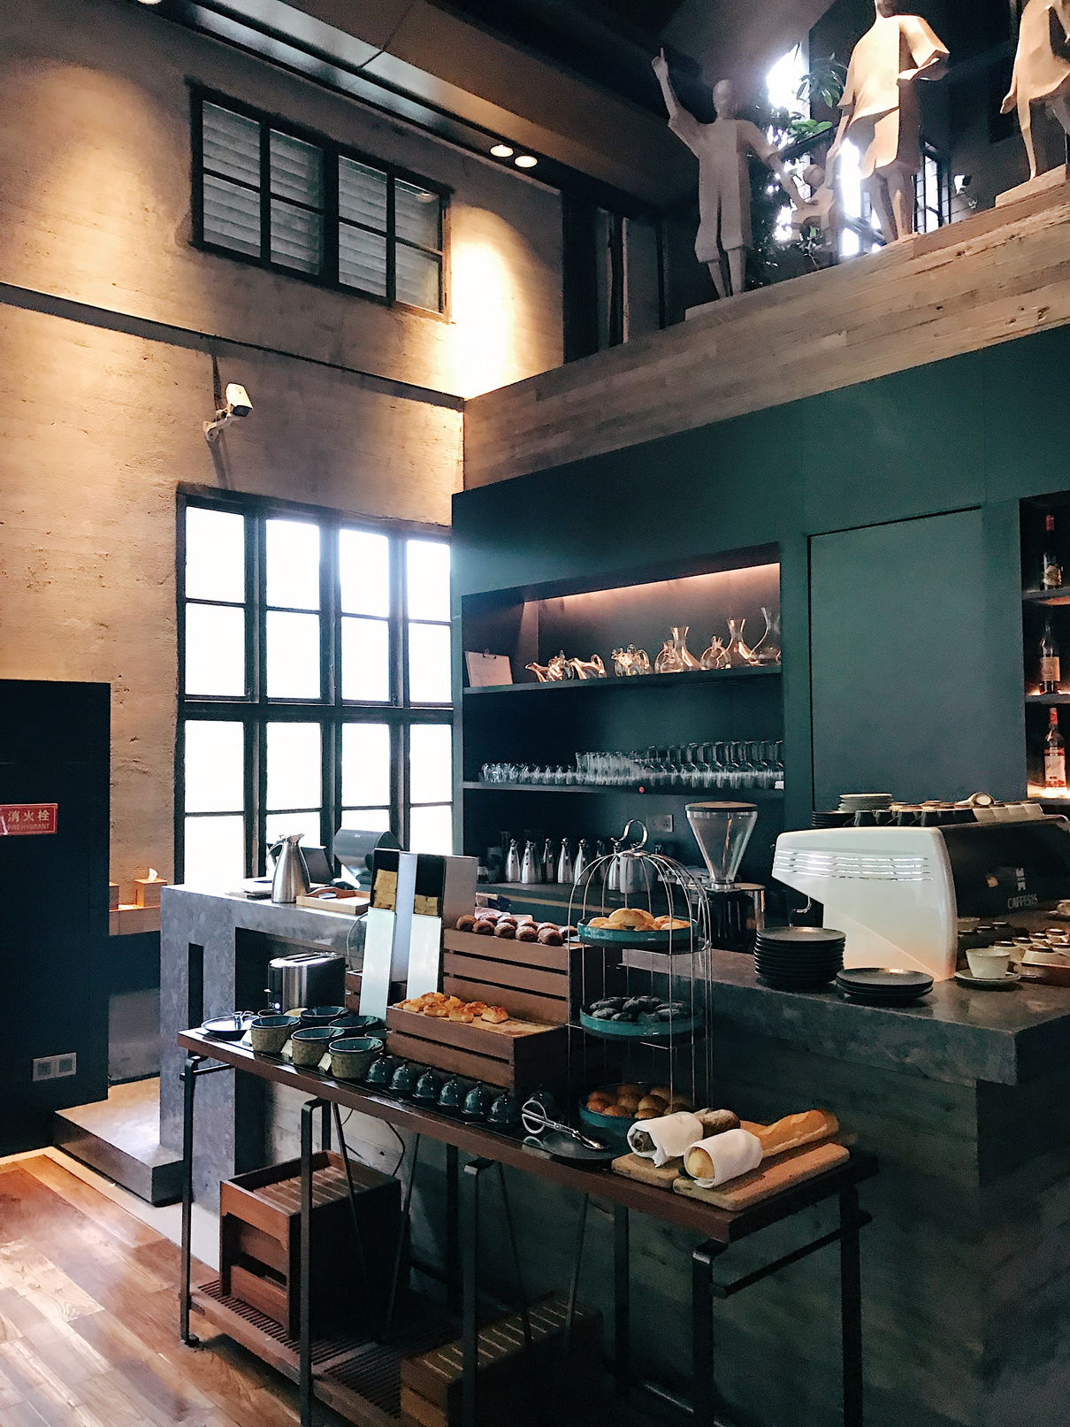
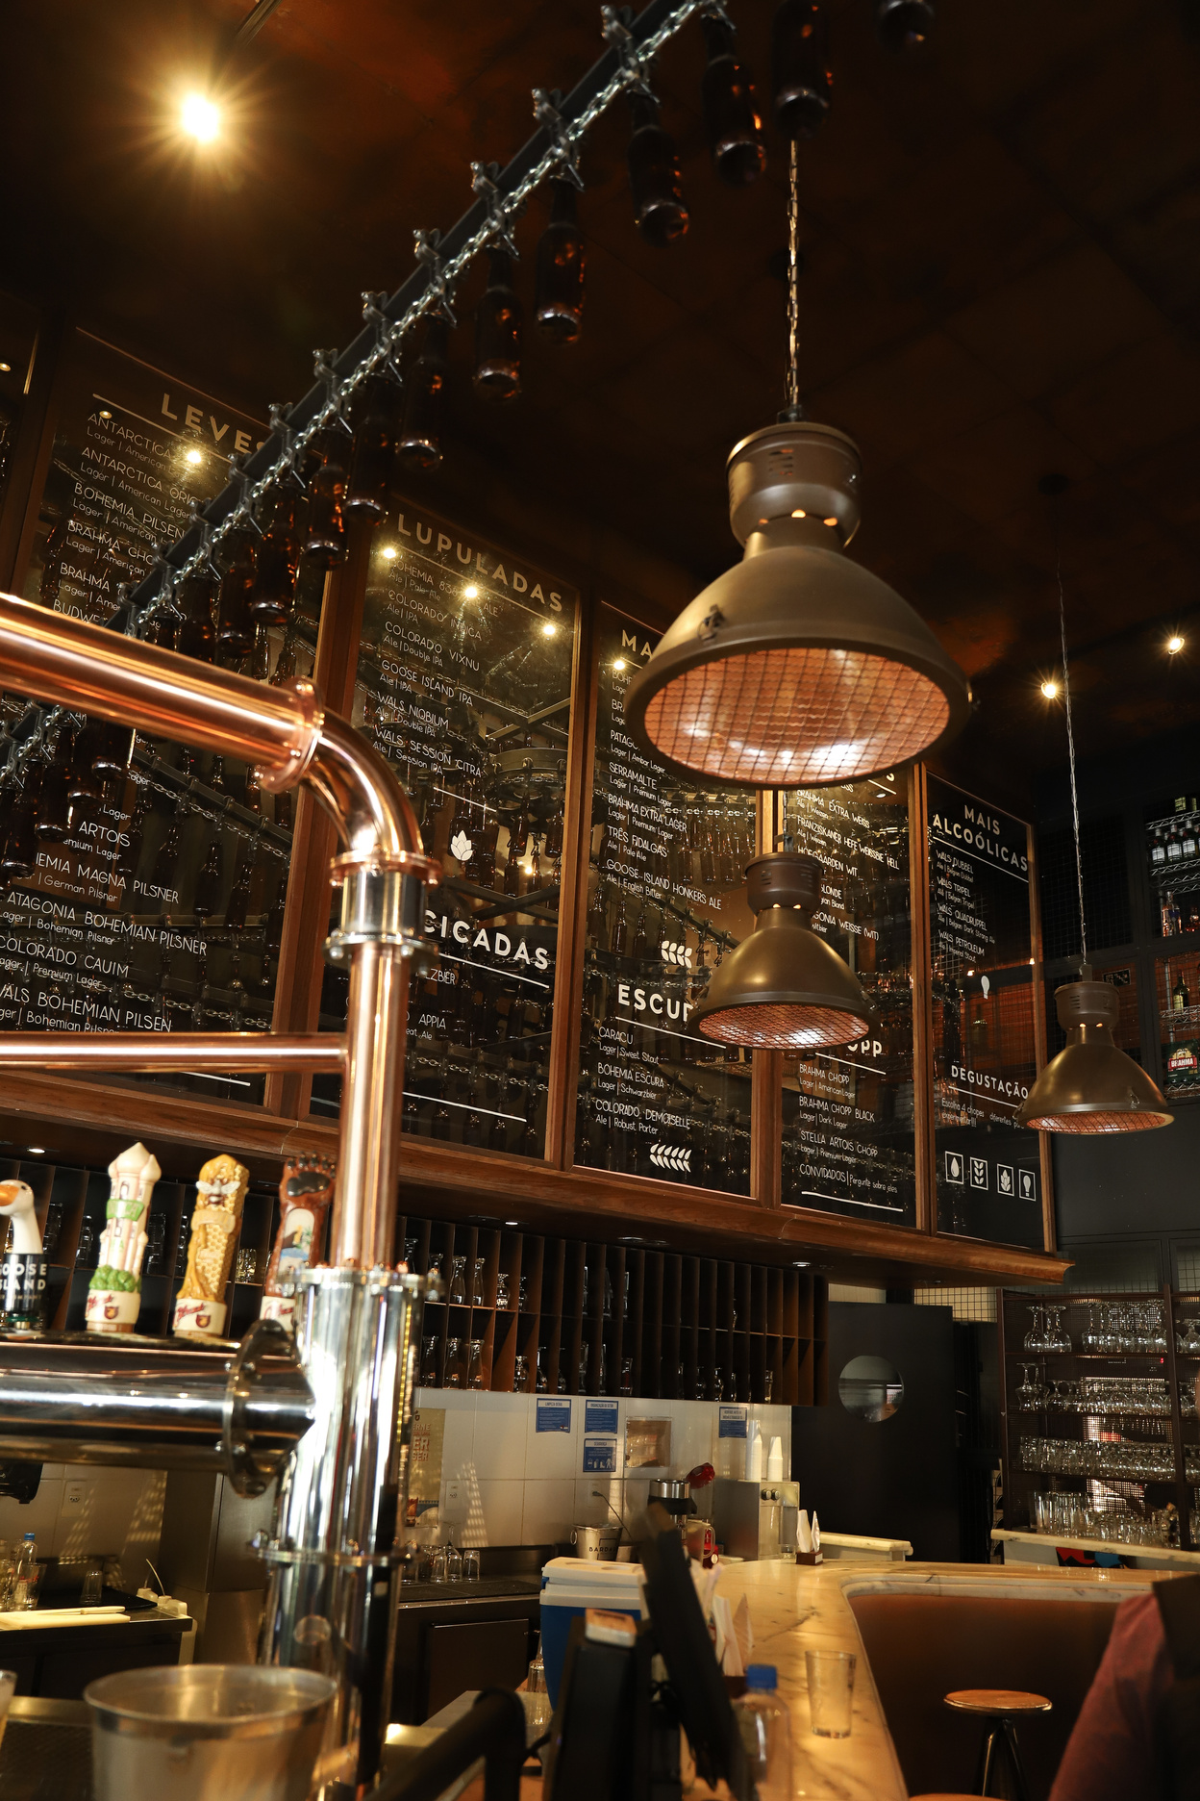

OBJECTIVE:
To explore coffee quality scores and identify trends, patterns, and key factors affecting coffee excellence.

Slide 4

DATASET OVERVIEW:
The dataset is divided mainly into 3 categories.
QUALITY MEASURES
FARM METADATA
BEAN METADATA
Aroma
Acidity
Flavor
Moisture
Sweetness
Owner
Country of origin
Farm name
Company
Region
Processing Method
Color
Species

Slide 5
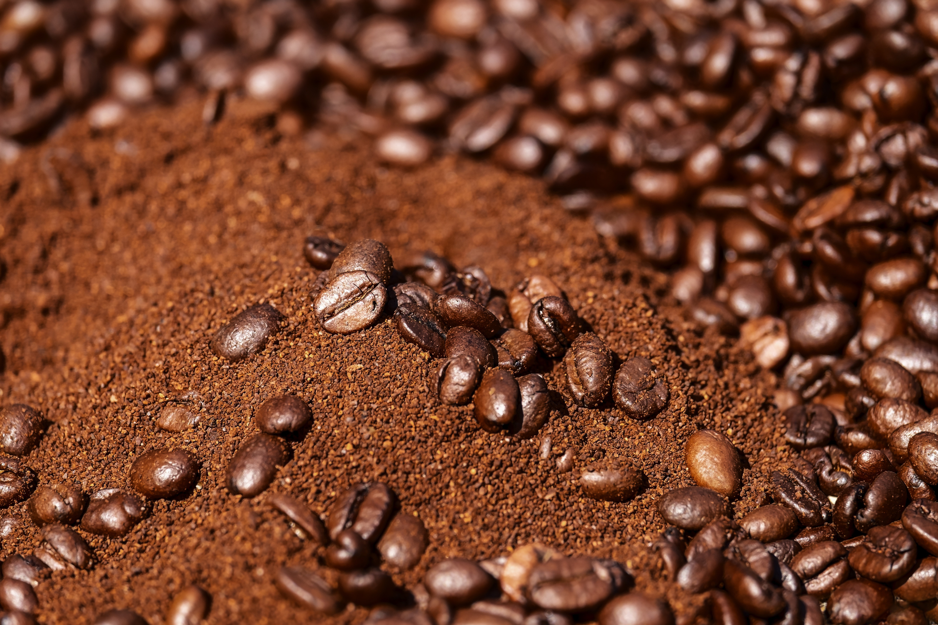
DATA CLEANING:
1. Remove Unnecessary Columns
2. Handle Missing Values
3. Handle Inconsistent Formatting
4. Fix Outliers
5. Standardize Text Columns
6. Remove Duplicates

Slide 6
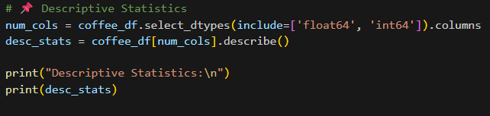
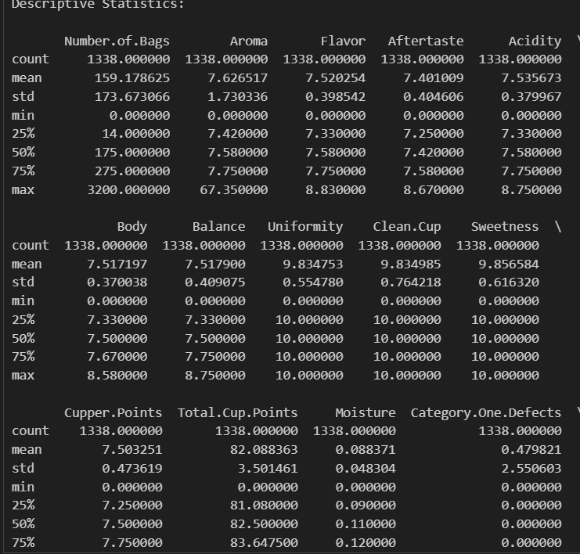
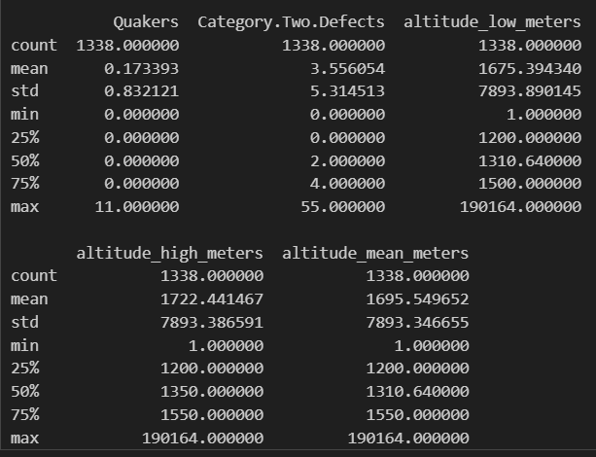
STATISTICAL ANALYSIS:
Descriptive Statistics:

Slide 7
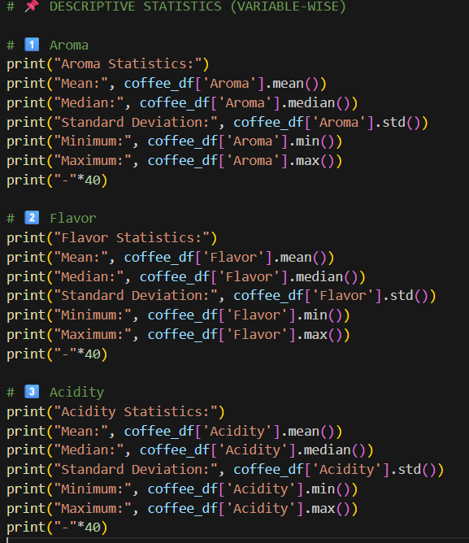
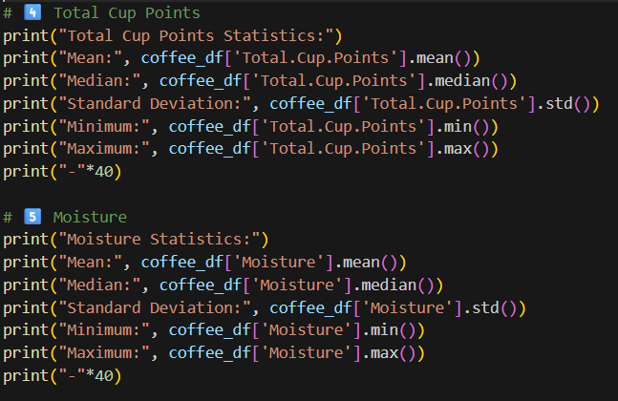
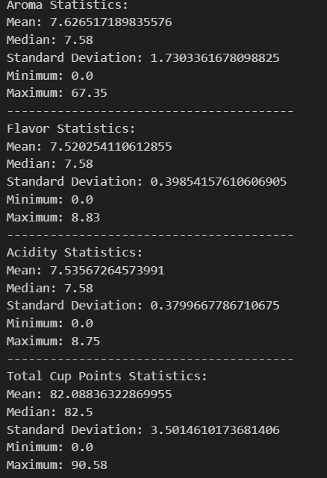
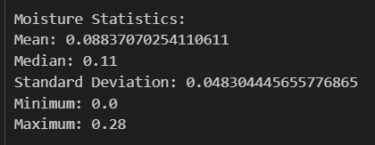
STATISTICAL ANALYSIS:
Descriptive Statistics:

Slide 8
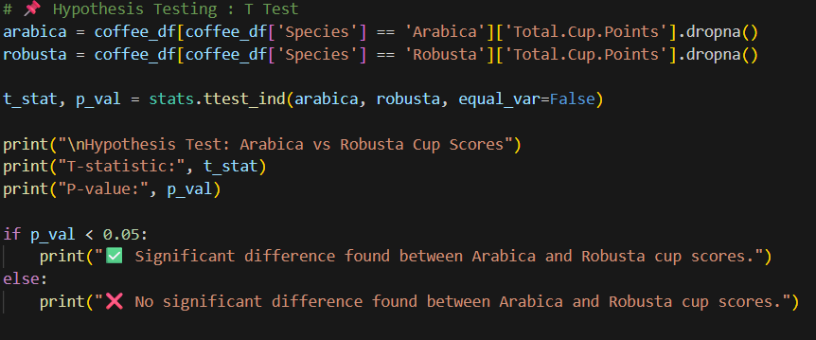
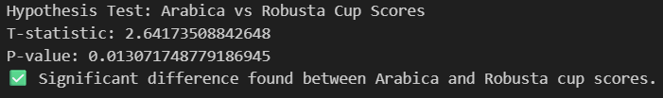
STATISTICAL ANALYSIS:
Hypothesis Test (t-test):

Slide 9
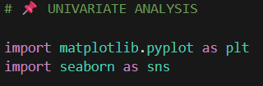
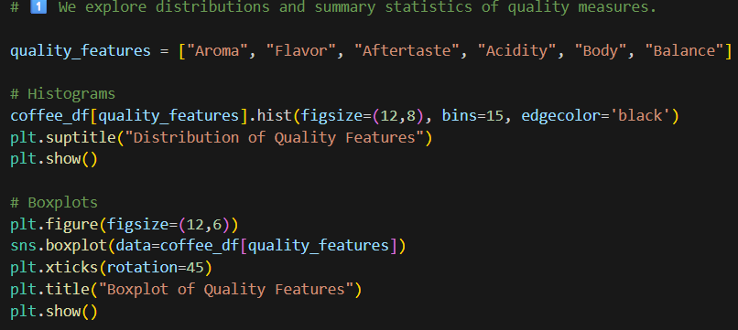
VISUALIZATION:
Univariate Analysis:

Slide 10
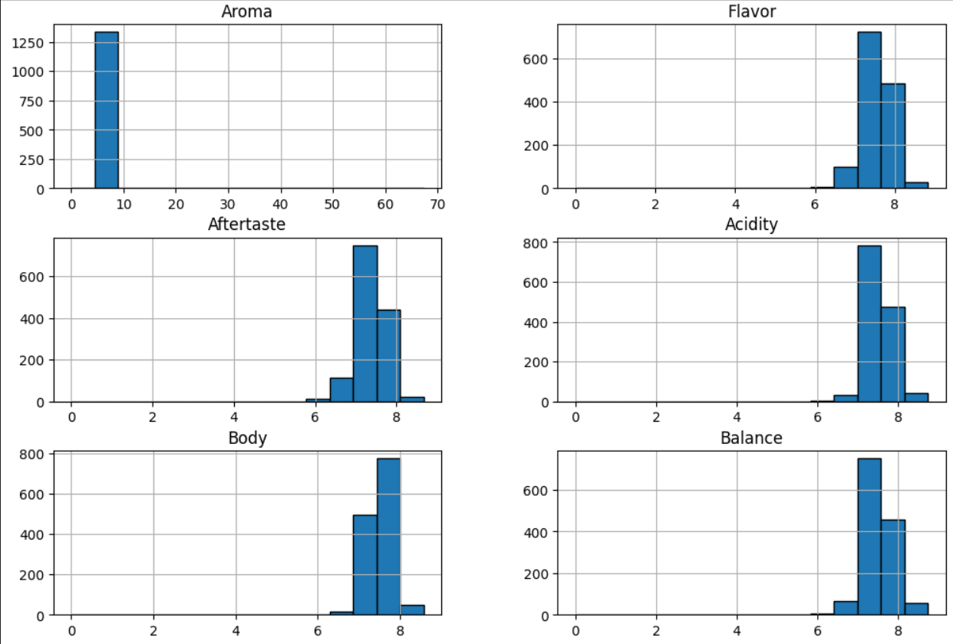
VISUALIZATION:
Univariate Analysis:

Slide 11
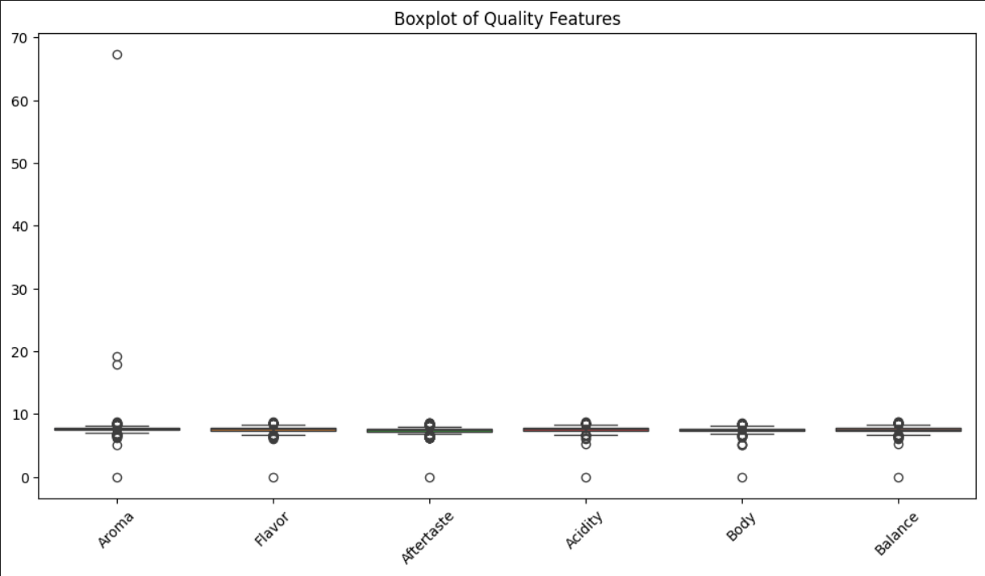
VISUALIZATION:
Univariate Analysis:
00

Slide 12
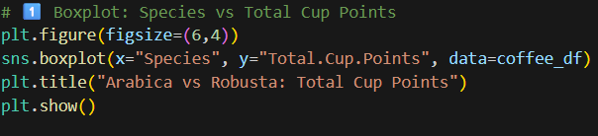
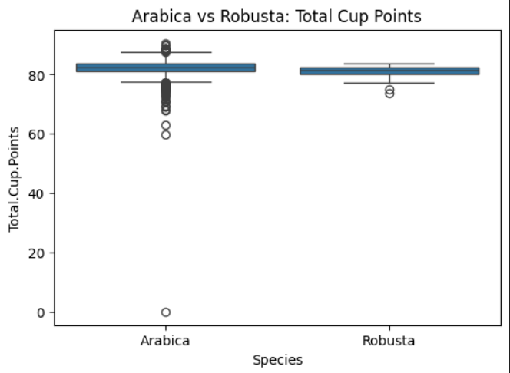
VISUALIZATION:
Bivariate Analysis:

Slide 13
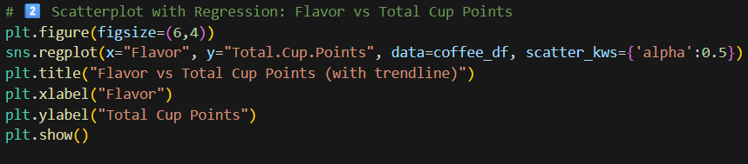
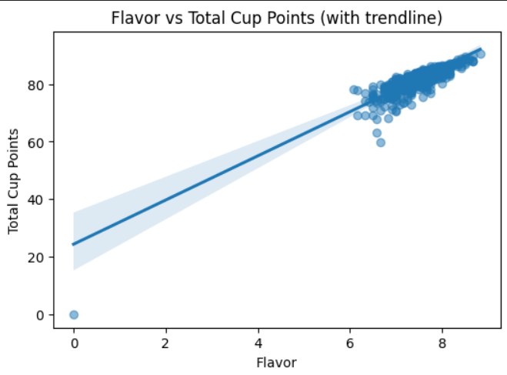
VISUALIZATION:
Bivariate Analysis:

Slide 14
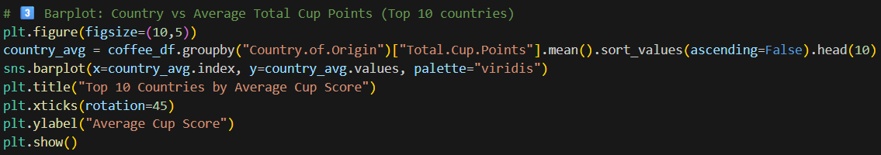
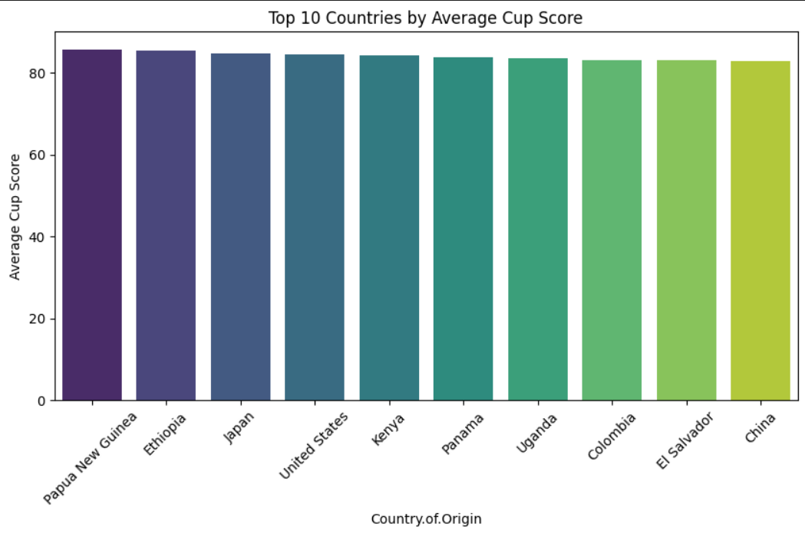
VISUALIZATION:
Bivariate Analysis:

Slide 15
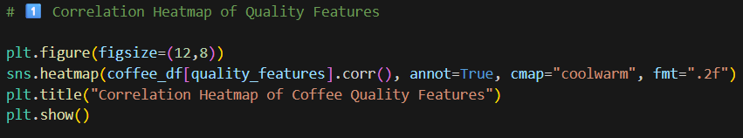
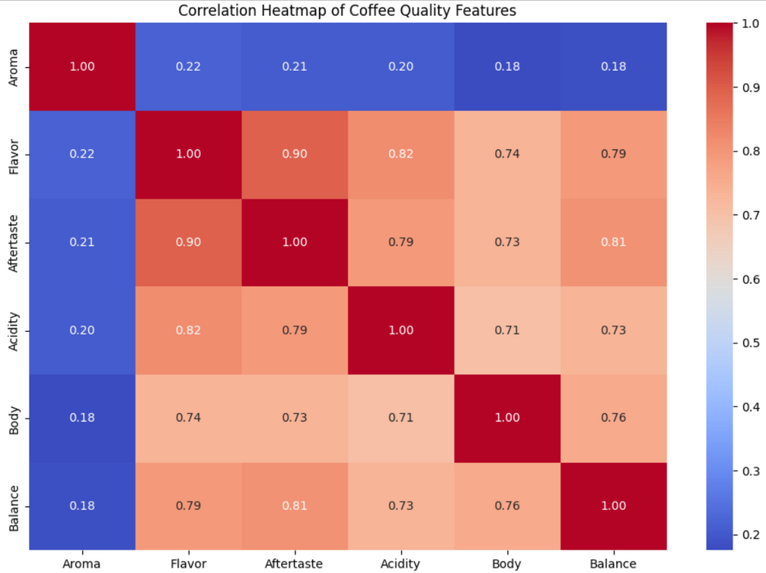
VISUALIZATION:
Multivariate Analysis:

Slide 16
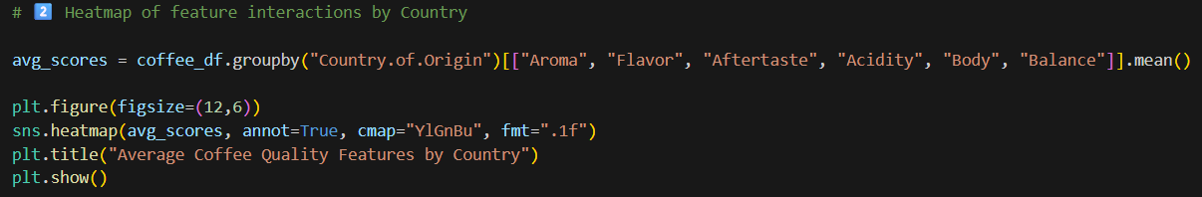
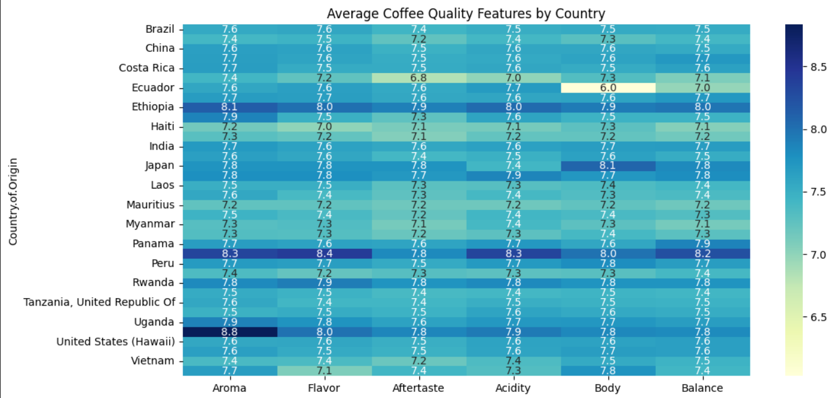
VISUALIZATION:
Multivariate Analysis:

Slide 17
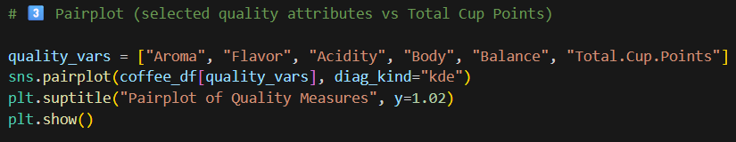
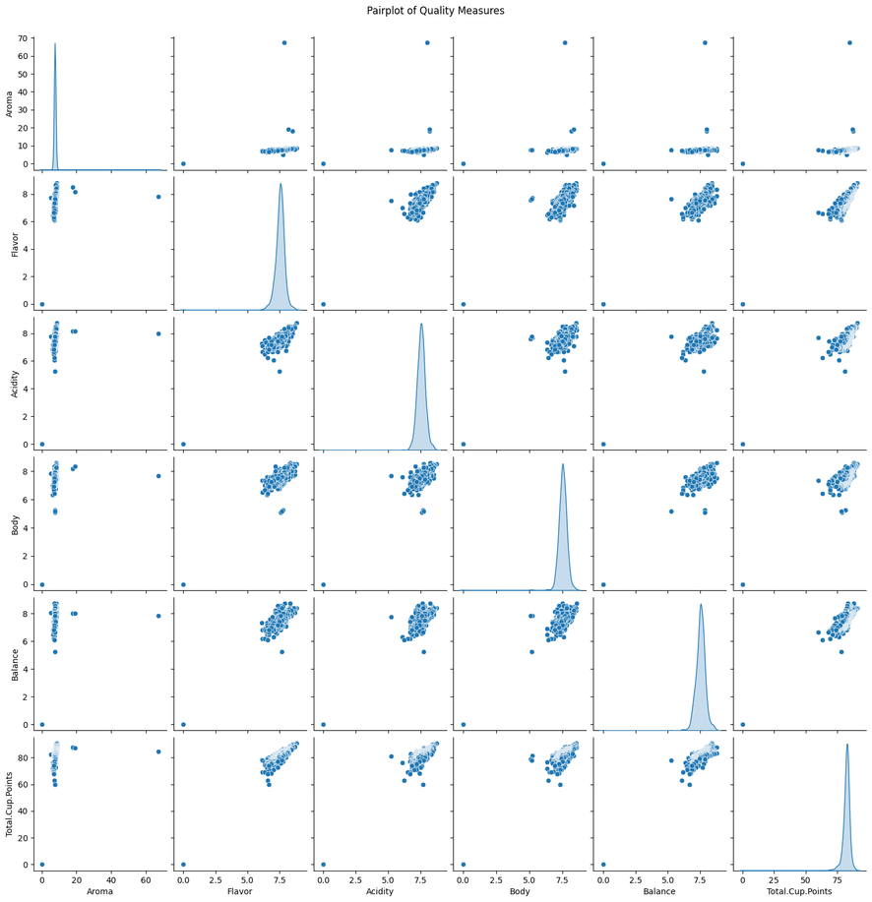
VISUALIZATION:
Multivariate Analysis:

Slide 18
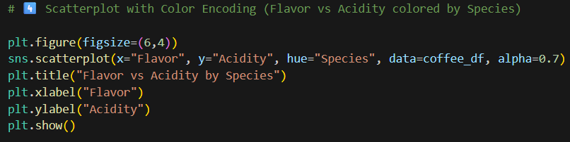
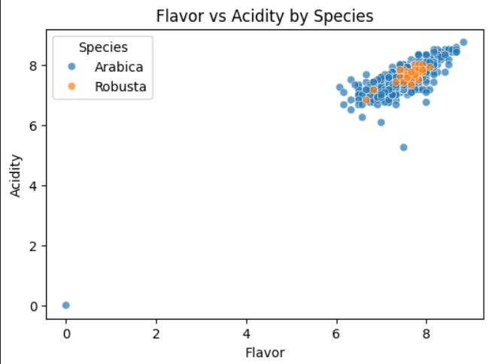
VISUALIZATION:
Multivariate Analysis:

Slide 19
INSIGHTS AND RECOMMENDATIONS:
1. Enhance Key Quality Attributes:
Finding: Aroma, Flavor, and Acidity show the strongest positive correlations with Total Cup Points.
Recommendation: Producers should focus on post-harvest processing techniques such as controlled fermentation, improved drying methods, and selective picking of ripe cherries to enhance these attributes.
2. Strengthen Defect Control:
Finding: While primary defects are rare, secondary defects occur more frequently and negatively impact overall quality.
Recommendation: Implement stricter sorting, grading, and quality checks during processing to reduce defective beans. Training workers on defect identification and investing in mechanical sorters can improve lot quality.

Slide 20
INSIGHTS AND RECOMMENDATIONS:
3. Maintain Optimal Moisture Content:
Finding: Average moisture is within the ideal range (~10%), but extremes (below 8% or above 12%) can harm quality and shelf life.
Recommendation: Standardize drying practices and adopt climate-controlled storage facilities to ensure beans remain within the safe moisture range.
4. Leverage Altitude for Quality Improvement:
Finding: Higher-altitude farms (>1500m) generally achieve better cup scores.
Recommendation: Lower-altitude farms can adapt shade-grown methods, improved soil fertility, and careful harvesting practices to partially replicate the benefits of high-altitude conditions.

Slide 21
INSIGHTS AND RECOMMENDATIONS:
5. Species Diversification and Innovation:
Finding: Arabica outperforms Robusta significantly in cup scores.
Recommendation:
For Arabica farms: Continue focusing on specialty-grade quality for premium markets.
For Robusta farms: Explore blends with Arabica or disease-resistant Arabica hybrids to improve market value without sacrificing resilience.
6. Country-Specific Knowledge Sharing:
Finding: Some countries (e.g., Ethiopia, Guatemala, Kenya) consistently produce higher-scoring coffees.
Recommendation: Establish knowledge-sharing programs across producing regions. Governments, cooperatives, and NGOs can facilitate farmer training programs and quality-based payment systems to uplift lower-scoring regions.

Slide 22

INSIGHTS AND RECOMMENDATIONS:
7. Data-Driven Buyer and Producer Decisions:
Finding: The dataset highlights measurable factors (altitude, processing method, species) that strongly influence quality.
Recommendation:
Buyers: Use data-driven insights to select reliable suppliers and reward consistent quality.
Producers: Leverage analysis results to optimize farming and processing decisions, aligning with global specialty coffee standards.

Slide 23




CONCLUSION:
Most coffees score in the specialty range (80–85 points).
Arabica consistently scores higher than Robusta.
Aroma, Flavor, and Acidity are the strongest drivers of coffee quality.
Defects and poor moisture control reduce overall cup scores.
Higher-altitude farms tend to produce better-quality coffee.

Slide 24

THANK YOU

